Slide 1


K.RAMAKRISHNAN COLLEGE OF TECHNOLOGY
(AUTONOMOUS), TRICHY.
DEPARTMENT OF
COMPUTER SCIENCE AND ENGINEERING
20CS5501 DESIGN PROJECT-1
Batch No. : 11
Date : 07.12.2024

Slide 2
MOVIR RECOMMENDATION SYSTEM
Guided by Team
Mrs. S Gayathri Santhosh T (811721104134)
Assistant Professor, CSE Shajeeth Rahman S (811721104138)
Vengatesan S (811721104179)

Slide 3
OBJECTIVE OF THE PROJECT
The primary objective of the Movie Recommendation System is to enhance the user.
Experience by providing personalized movie suggestions.
This system aims to analyze user preferences, past behaviours, and trends.
Recommend movies that align with their tastes, making it easier for users to discover films they are likely to enjoy.
Analyze movie attributes such as genres, directors, to identify similarities and recommend movies that match user preferences.

Slide 4
ABSTRACT
Recommendation System is a system that seeks to predict or filter preferences according to the user’s choices. Recommendation systems are utilized in a variety of areas including movies, music, news, books, research articles, search queries, social tags, and products in general, It is a simple algorithm whose aim is to provide the most relevant information to a user by discovering patterns in a dataset. The algorithm rates the items and shows the user the items that they would rate highly. An example of recommendation in action is when you visit Amazon and you notice that some items are being recommended to you or when Netflix recommends certain movies to you. They are also used by Music streaming applications such as Spotify and Deezer to recommend music that you might like We can make this application using python language and collaborative based filtering algorithm.Collaborative filtering tackles the similarities between the users and items to perform. The next movie recommendation should be based on the user’s rating to watched movies.

Slide 5
LITERATURE SURVEY
TITLE OF THE PAPER | AUTHOR (S) | PUBLISHER | PAPER GIST | TECHNOLOGY USED
Collaborative Filtering for Movie Recommendation | John Smith, Maria Garcia | IEEE Xplore | This paper explores collaborative filtering techniques, focusing on user preferences to recommend movies. | Collaborative Filtering, Matrix Factorization
Content-Based Movie Recommendation Systems | Alice Johnson, Robert Lee | Springer | Focuses on content-based recommendation, using movie metadata (genre, director, etc.) to make personalized recommendations. | Natural Language Processing (NLP), TF-IDF
Hybrid Movie Recommendation System | David Martin, Emily Rodriguez | ACM Digital Library | Combines collaborative filtering and content-based methods to improve recommendation accuracy. | Collaborative Filtering, Content-Based Filtering, Hybrid Models

Slide 6
PROPOSED SYSTEM ARCHITECTURE
The proposed system will leverage a hybrid recommendation approach that combines collaborative and content- based filtering methods. The system will consist of the following components:
Data Collection: Gathering user data, such as movie ratings, genres of interest, and viewing history.
Pre-processing: Cleaning and organizing the data to ensure it is suitable for analysis. This includes handling missing values, normalizing data, and feature extraction.
Model Training: Using collaborative filtering to learn patterns in user behavior and content-based filtering to analyze movie features.

Slide 7
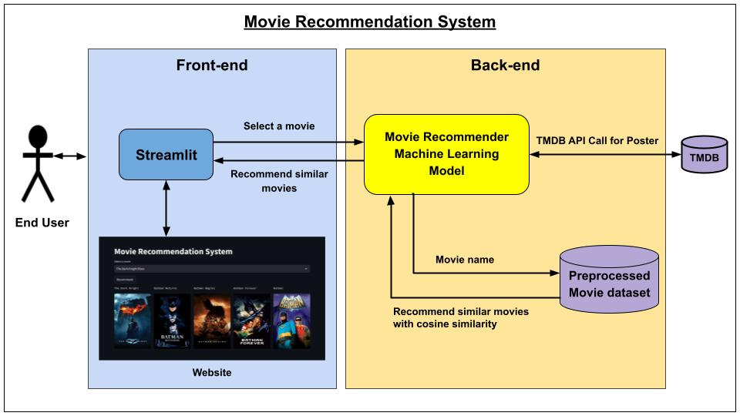
EXISTING SYSTEM ARCHITECTURE

Slide 8
SOFTWARE AND HARDWARE REQUIREMENTS
HARDWARE
SOFTWARE
Processor: Intel i5 or higher
RAM: 8 GB or more- Storage: Minimum 500 GB HDD/SSD
Graphics Card: Not mandatory, but NVIDIA/AMD for deep learning models is preferable.
Internet Connection: Stable high-speed connection for real-time data fetching and updates .
Operating System: Windows 10/11, Linux, or macOS
Programming Language: Python 3.x or later.
Libraries: NumPy, Pandas, Scikit-learn, TensorFlow/PyTorch (for deep learning.
Database: MySQL/PostgreSQL/
IDE: PyCharm, Jupyter Notebook, or Visual Studio Code

Slide 9
MODULES
Data Collection Module
Pre-processing Module
Model Training Module
Recommendation Module
User Interface Module

Slide 10
SUMMARY OF MODULE-1
Goal: Gather and store user and movie data.
Implementation:
Data Source Identification: Identify sources of data. This could be public APIs.
Data Collection:
Movie Data: Collect metadata about movies, including movie titles, genres, cast, director, release year, ratings, and descriptions.
Data Storage: Store the collected data in a database (e.g., MySQL, PostgreSQL, or a NoSQL database like MongoDB).

Slide 11
SUMMARY OF MODULE-2
Goal: Clean, transform, and prepare the data for model training.
Implementation:
Data Cleaning:
Handle missing or incomplete data (e.g., null values in movie metadata or user ratings).
Remove duplicates, invalid entries, or outliers (e.g., users with highly inconsistent ratings).
Data Transformation:
Extract features such as genre, year, or director into structured columns (One-Hot Encoding or Label Encoding for categorical features).

Slide 12
SUMMARY OF MODULE-3
Goal: Build and train the recommendation model using machine learning algorithms.
Implementation:
Select Model Type: Choose the recommendation algorithm based on your system’s needs. Common approaches include:
Collaborative Filtering: User-based or Item-based Collaborative Filtering (using similarity measures like cosine similarity, Pearson correlation).
Content-Based Filtering: Use movie metadata (genre, director, cast) and user profile data.
Hybrid Methods: Combine collaborative filtering and content-based filtering for improved recommendations.

Slide 13
SUMMARY OF MODULE-4
Goal: Provide movie recommendations to users based on their preferences and behavior.
Implementation:
Generate Recommendations:
For collaborative filtering: Recommend movies based on the user’s historical ratings or the ratings of similar users.
Personalization: Incorporate personalization techniques, such as:
Ranking the recommended movies based on relevance to the individual user.
Filtering out already watched movies or those the user has rated highly.

Slide 14
SUMMARY OF MODULE-5
Goal: Provide a user-friendly interface where users can interact with the recommendation system.
Implementation:
UI Design:
Design the interface (web app, mobile app, or desktop app) where users can:
View personalized recommendations.
View movie details (e.g., description, genres).
Recommendation Display:
Display movie recommendations with relevant metadata such as title, poster, genre, and a short description.

Slide 15
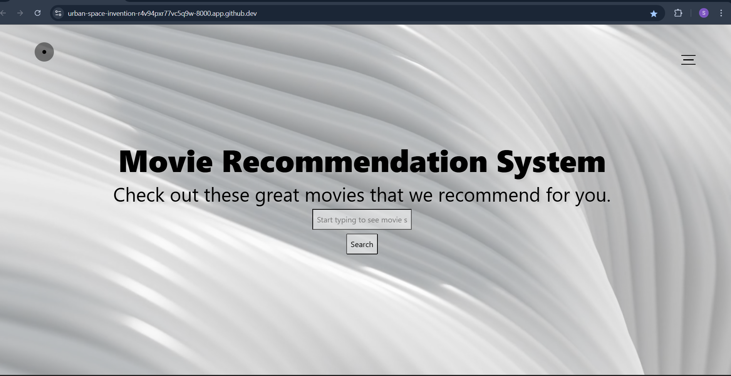
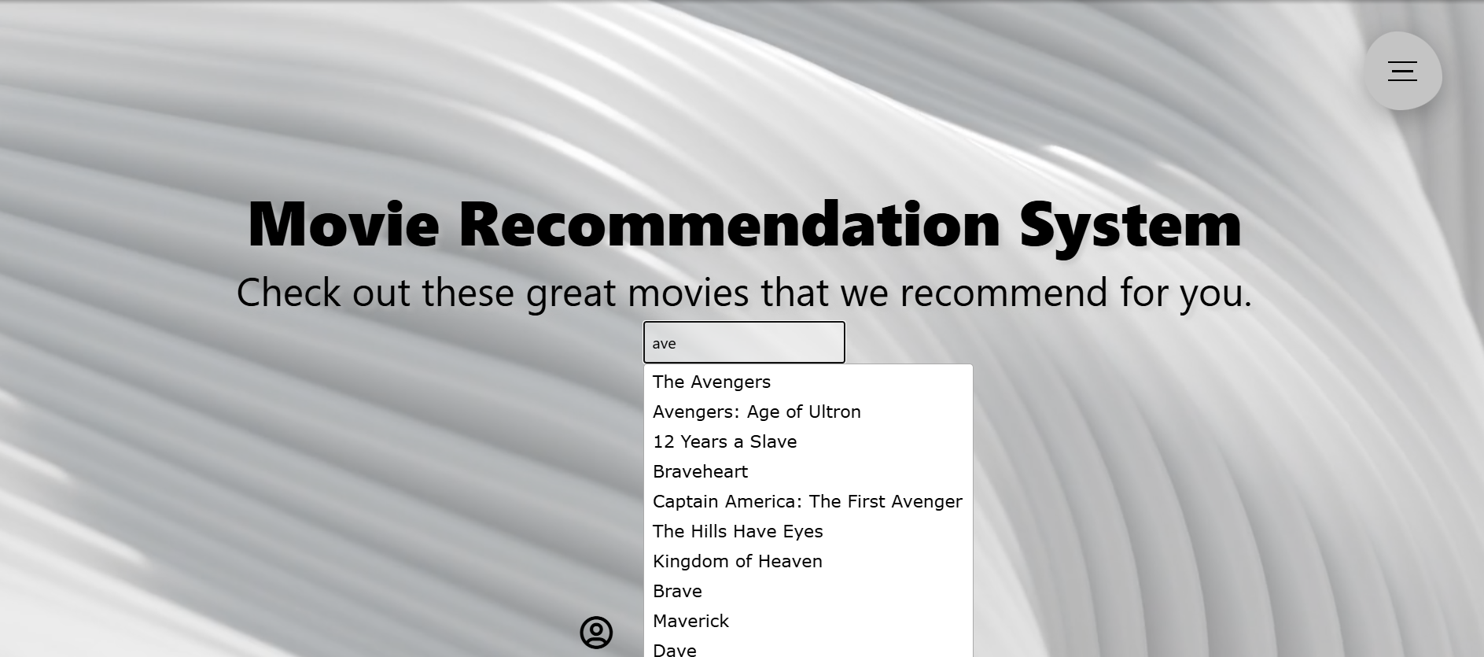
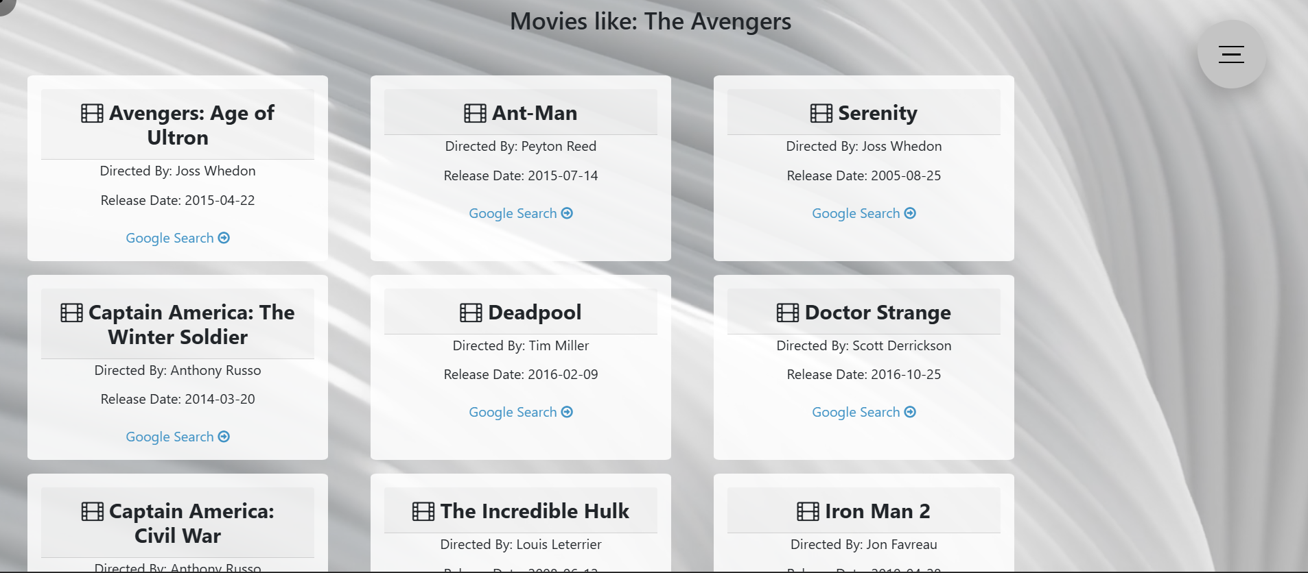
RESULTS AND DISCUSSION

Slide 16
CONCLUSION
The Movie Recommendation System proved to be an effective tool for enhancing user engagement and satisfaction in movie discovery.
The project underscored the importance of using a hybrid approach to balance different recommendation techniques
This system lays a strong foundation for further advancements in personalized content recommendation technologies.
The system provides users with tailored movie recommendations, enhancing their overall movie-watching experience.
The system's modular design and use of Python enable easy integration with new data sources and adaptation to changing user preferences.

Slide 17
THANK YOU

